Slide 1



Safety and Quality Program for Residents
Pharmacy Residency Program
Deanship of Postgraduate Education
Quality Department

Slide 2


Theme Four: Mentorship

Slide 3
Mentorship: a collaborative relationship between a more experienced individual and a less experienced individual that is focused on the mentee's personal and professional development.

Slide 4
Matching
Specialty
Goals
Compatibility
Research experience

Slide 5
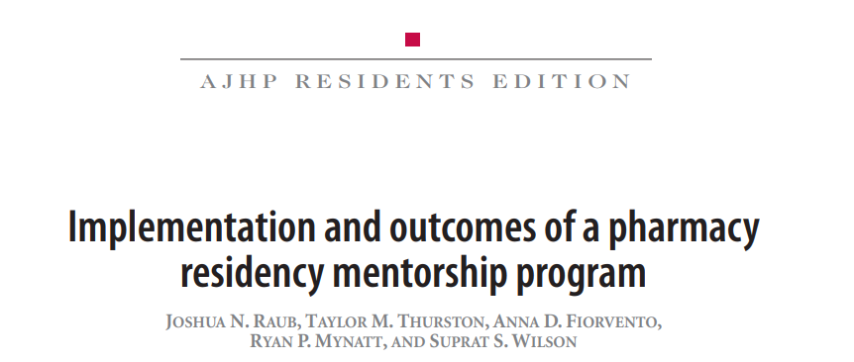

Slide 6
Process
Residents had up to 2 months to choose a mentor
Potential mentors were involved during residents orientation
The RPD was omitted as a possible mentor
A lecture was given to the mentors and residents

Slide 7
Results
The majority of residents agreed that having a mentor was beneficial.
Most participants were planning on staying in contact with their mentors after residency.
Half of the residents met with their mentors multiple times per month.
A year after implementation of the program, 100% of the residents were employed or matched to a residency program.

Slide 8
Feedback
The majority of residents believed that the 2 months deadline was rushed.
The residents suggested an annual workshop for those involved in the mentorship program.

Slide 9
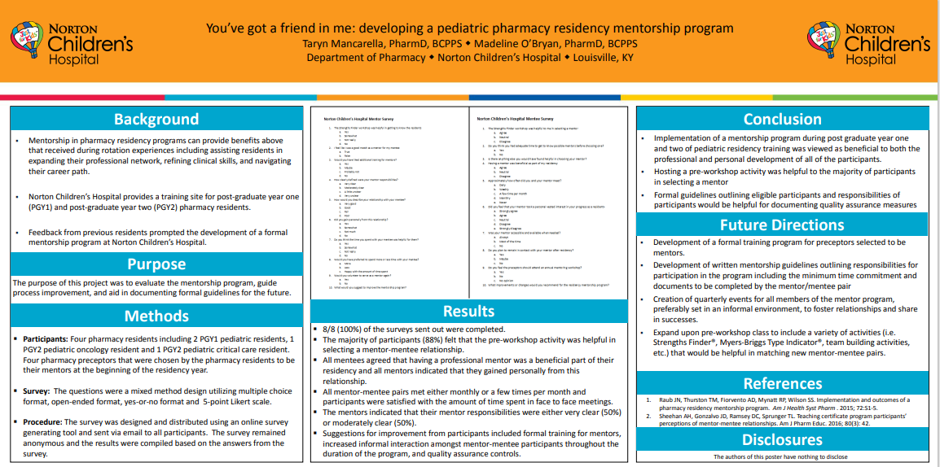

Slide 10
Results
Development of
  A formal training program for preceptors selected to be mentors.
  Written mentorship guidelines outlining responsibilities for participation in a program including the minimum time commitment and documents to be completed by the mentor/mentee pair.
  Quarterly events for all members of the mentor program, preferably set in an informal environment to foster relationships and share success.

Slide 11
Future Plans
Mentorship guideline
Benefits
Two-directional, biannual evaluation

Slide 12
What would motivate you to be a mentor?

Slide 13
Thank you

