Slide 1



Safety and Quality Program for Residents
Pharmacy Residency Program
Deanship of Postgraduate Education
Quality Department

Slide 2


Theme Five: Antimicrobial Stewardship

Slide 3
Antimicrobial Stewardship Elements
Shorter is better
IV to oral switch
Time to administration
Streamlining
Pre-authorization and restriction

Slide 4
What is the role of clinical pharmacists/residents in antimicrobial stewardship?

Slide 5
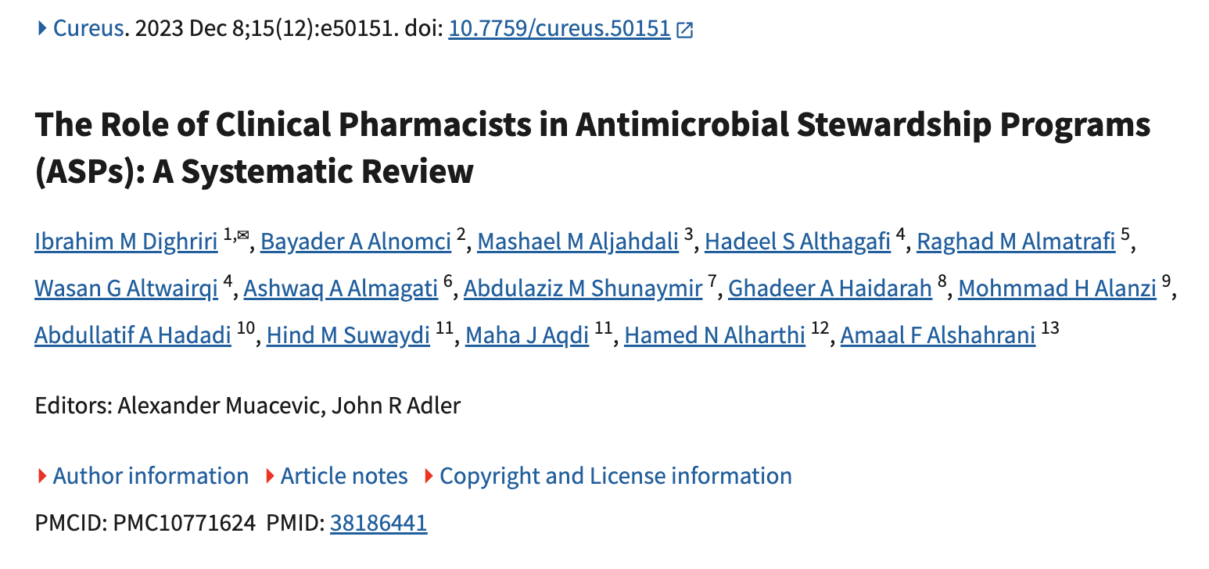

Slide 6
Results
Decrease in time to administration of appropriate antibiotic therapy and improved compliance with local and national prescribing guidelines without affecting hospital readmission
Intravenous to oral conversion and shortening therapy duration safely reduced excessively long antibiotic courses and length of hospital stay
High acceptance rates of pharmacist recommendations by physicians, demonstrating the credibility of pharmacists
Significant reduction in overall antibiotic use, associated costs, and excessive therapy duration, leading to substantive cost savings

Slide 7
Antimicrobial Stewardship Goal
Optimize clinical outcomes while minimizing unintended consequences of antimicrobial use

Slide 8
Critical Balance of Antibiotic Use

Slide 9
Critical Balance of Antibiotic Use
Antimicrobial Stewardship
Mortality increases when initial therapy is inappropriate
Resistance increases when broad-spectrum agents are overused

Slide 10
Thank you

